Slide 1
Tablue project call center
File created on: 1/11/2024 4:41:05 PM

Slide 2
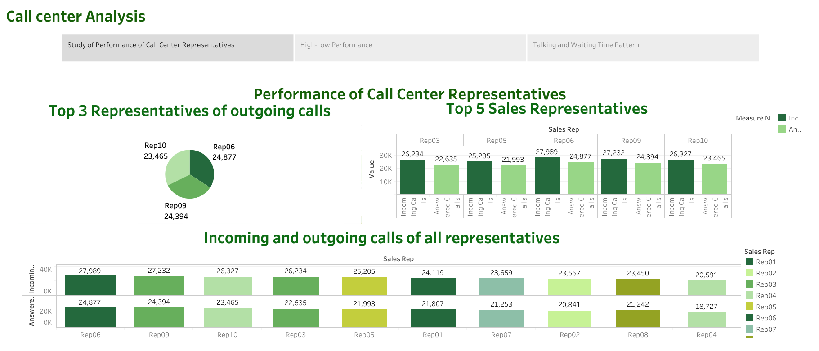

Slide 3
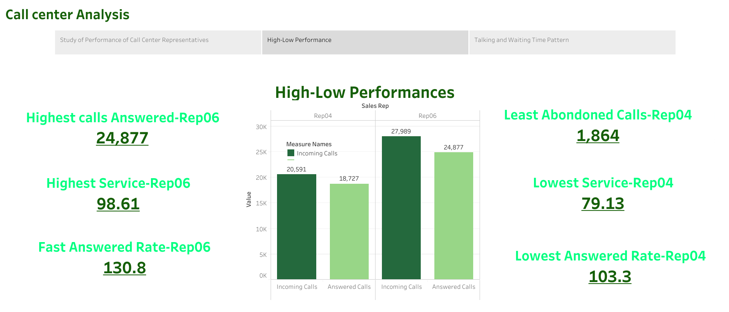

Slide 4
